Slide 1

The Global Dementia Environment
Yves Joanette, PhD, FCAHS
Chair, World Dementia Council
ADNI Meeting
Toronto, 2016

Slide 2
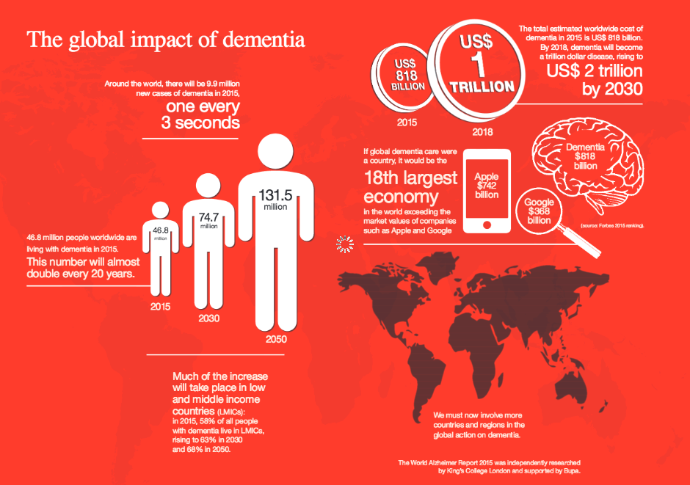
World Alzheimer Report 2015: The Global Impact of Dementia

Slide 3
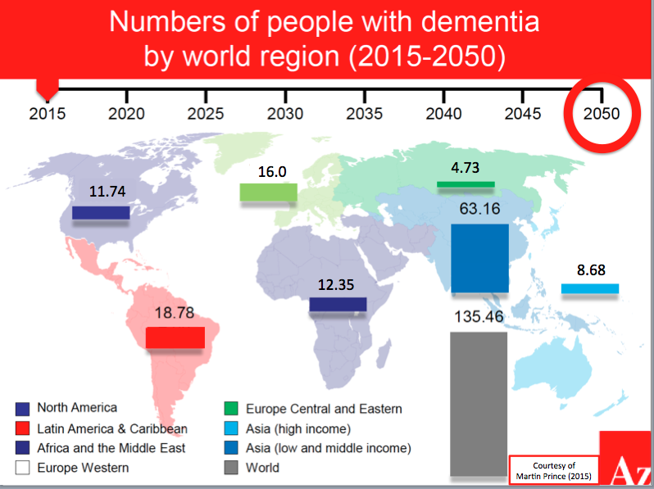

Slide 4
The Global Dementia Challenge
Dementia is one of the most crucial public health challenges (WHO and ADI)
Not limited to high-income countries
Particularly challenging for low- and middle-income countries
There is a a global collaboration and synergy between:
WHO which brings together Member States and supports the Global Dementia Observatory
The World Dementia Council which provides a complementary role of bringing together individuals from all stakeholders groups in order to support, amplify and coordinate a global response
In coordination with ADI and OECD
Connecting with other initiatives (e.g., GBHI, GCBH)

Slide 5
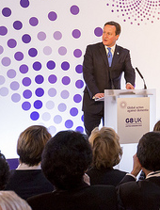
The Initial World Dementia Council
In Dec 2013, UK hosted a G8 Dementia Summit
Goal was to bring together experts across the world to start a global conversation about solutions for dementia
The Summit resulted in a declaration that set out an international response to dementia with the aim of identifying a cure or a disease modifying therapy by 2025

Slide 6
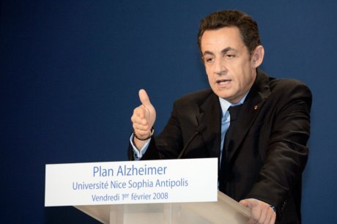
The Initial World Dementia Council
In Dec 2013, UK hosted a G8 Dementia Summit
Goal was to bring together experts across the world to start a global conversation about solutions for dementia
The Summit resulted in a declaration that set out an international response to dementia with the aim of identifying a cure or a disease modifying therapy by 2025
France’s President Sarkozy had put Alzheimer as a national priority in 2008 and lead a European rally around collaborative research at the origin of JPND

Slide 7
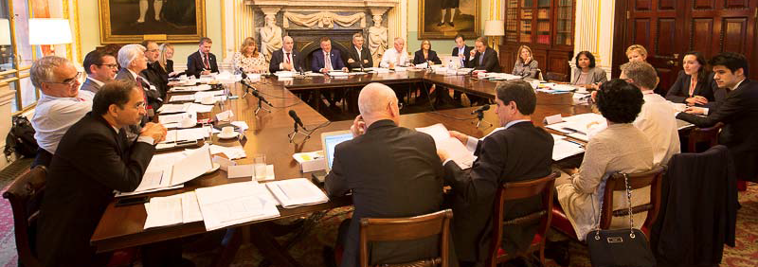
The Initial World Dementia Council
In February 2014, the UK Prime Minister appointed Dr Dennis Gillings as the World Dementia Envoy & established the World Dementia Council (WDC)
WDC Members are from a wide range of experts from research, academia, industry, the NGO sector, people living with dementia & governments
World Dementia Council Full Members, February 2016

Slide 8
G7 to Global – The Continuity Model
Following the WHO First Ministerial conference in March 2015 a broad consensus was reached amongst key global stakeholders & the WDC, on a global model to pursue with the challenge of dementia
A complementarity approach:
Establishment of the WHO Global Dementia Observatory
Actions from the WDC Global Teams that are independent of governments & any one organisation or sector
No formal governance between these two pillars, but a collaborative approach to optimize global impact

Slide 9
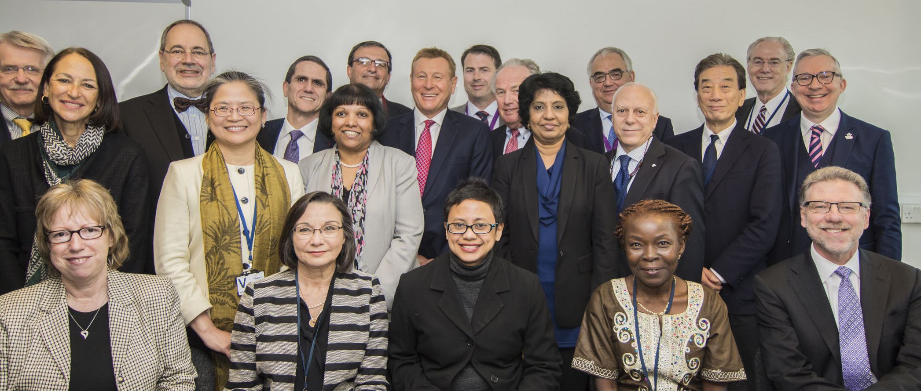
The Current World Dementia Council
Since February 2016, WDC membership has been expanded globally
New members drawn from a range of sectors & organisations across the wider global dementia community (24 Members)
Chair/Vice-Chair – Yves Joanette/Raj Long

Slide 10
Current Priorities of the Council
Global Team 1 - Raj Long, Lead
Global Team 2 – Chris Llewellyn, Lead
Global Team 3 – Philippe Amouyel, Lead
Global Team 4 – Harry Johns, Lead
Global Team 5 – Ron Petersen, Lead
Favor integrated drug development
Advocate for innovative and global finance models
Encourage open science collaborative global research including big data
Stimulate adequate care for people living with dementia and their carers in high, middle and low-income countries
Facilitate the identification and the dissemination of risk reduction strategies
Integrating cross-cutting themes
Women and dementia
Awareness
Stigma
Inequalities

Slide 11
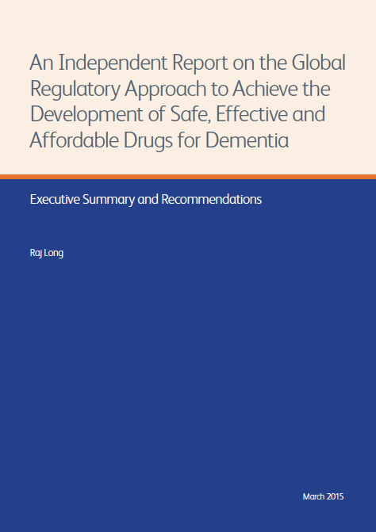

Slide 12

Progress – Finance Models
In March 2015, the WDC helped to shape the UK Govt-led work to establish the Dementia Discovery Fund – a ground breaking public/private venture capital fund which aims to finance pre-clinical research to find new drugs to treat dementia. The initial fund level is just over $100m & it aims to raise a further $100m during 2016

Slide 13

Progress – Research, Open Science and Big Data

Slide 14

Progress – Care

Slide 15
The World Dementia Council Moving Forward
The World Dementia Council is now ready to move forward
The 5 Global Teams made up of Council Members and other experts will facilitate moving forward on all five priorities and cross-cutting themes
The World Dementia Council will be working closely with WHO, OECD, ADI, Industry and all stakeholders to help promote, connect the dots and accelerate truly global approaches and solutions
Important Action-Meeting on July 28-29 in Toronto

Slide 16

The World Health Organization Moving Forward
WHO first highlighted the challenge of dementia in 2012
WHO organized in March 2015 the First Ministerial Conference on Dementia with an action plan endorsed by more than 90 countries
The next step is that the World health Assembly would adopt a Global Dementia Action Plan
On May 27, 2016, 19 countries proposed a resolution in that sense to the Executive Board of the WHA, which was strongly endorsed
The process towards a Global Action Plan is engaged and could be submitted to the WHA in 2017
The work on the Global Dementia Observatory has started (July 2016, Geneva)

Slide 17

Altogether …. Moving Forward
Member
States
WHO
Funders
NGOs
JPND
IADRFC
WW-ADNI
ADI
PLWD
GCBH
GBHI
CEOi
Academia
Industry

Slide 18
The Global Dementia Environment
info@worlddementiacouncil.com
ADNI Meeting
Toronto, 2016

